Slide 1
Coit11241
Cybersecurity Technologies

Slide 2
CIS 9.2

Slide 3
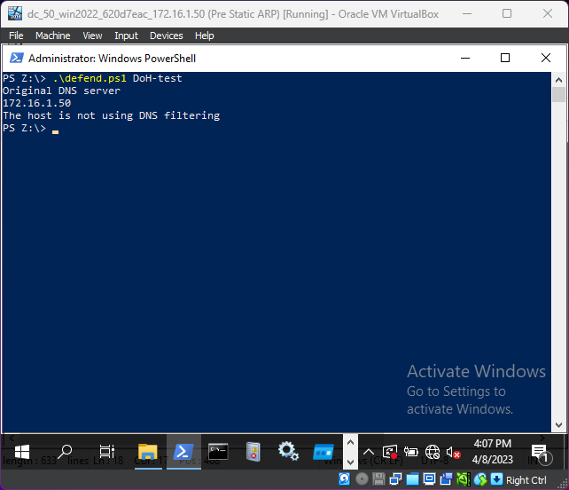
Function testDNSBlock()
Ran the DoH-test script to tests its functionality
Works as intended

Slide 4
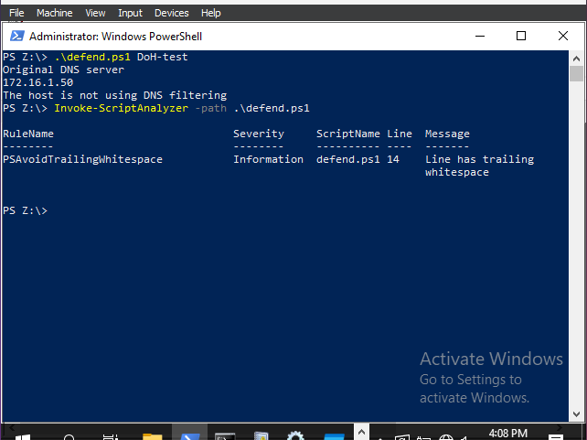
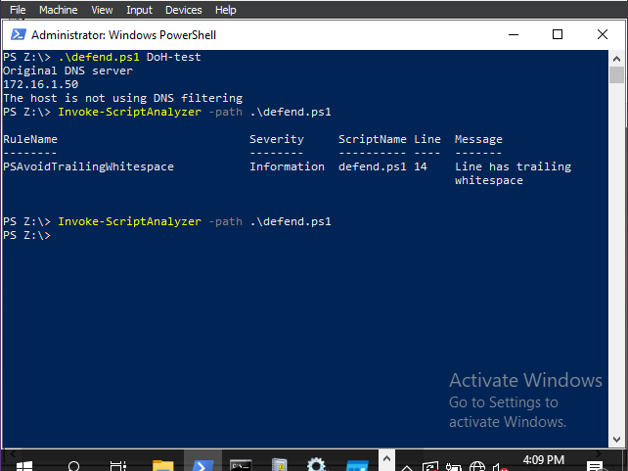
Ran script analyzer to ensure the script had no issues
1 issue found and fixed
Issues found
Trailing white space line 14

Slide 5
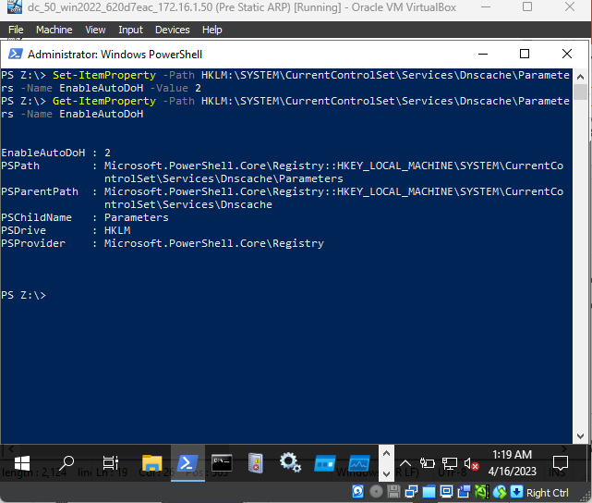
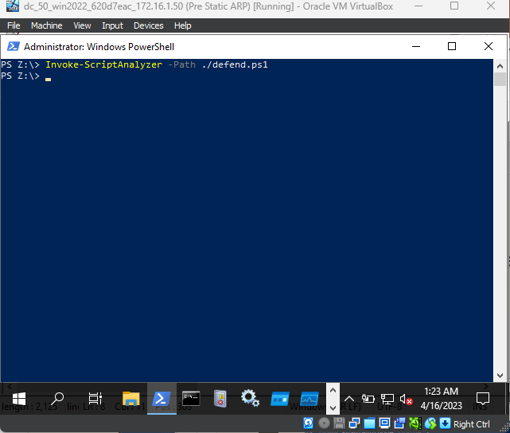
Function enableDoH()
Tested script used in the function without restarting pc
Functions correctly and no issues in script analyzer

Slide 6
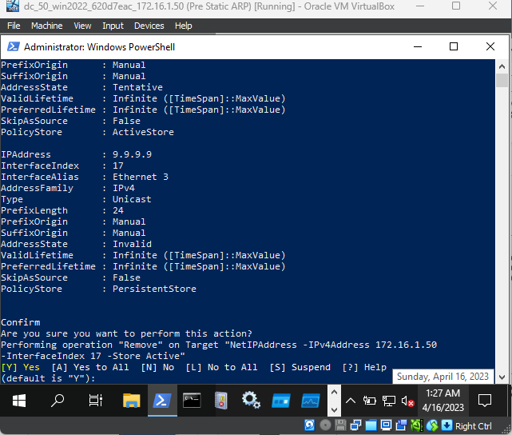
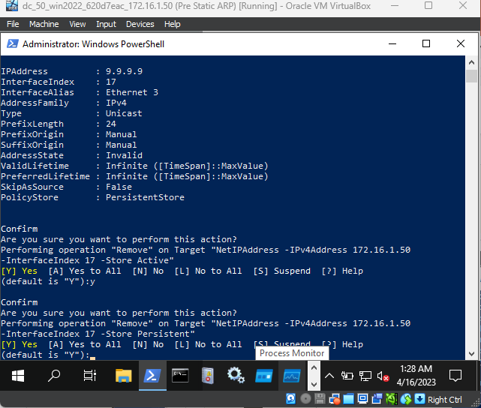
Function setupQuadDoH()
Tested adding a new IPAddress and removing the old IPAddress from the ethernet 3

Slide 7
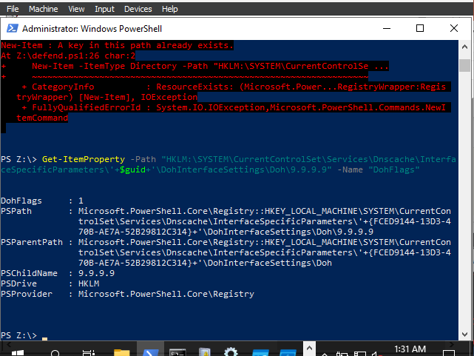
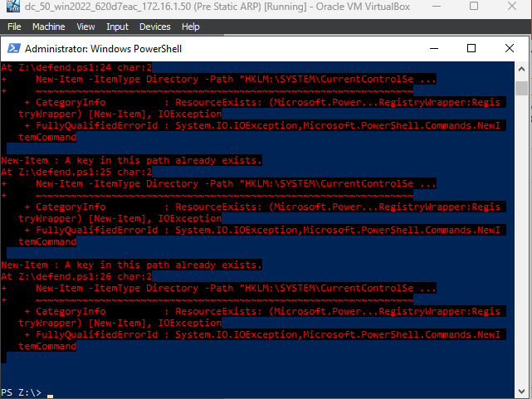
Tested the item property of DoHFlags to ensure the value was 1
If the directory's already exist it will not add them

Slide 8
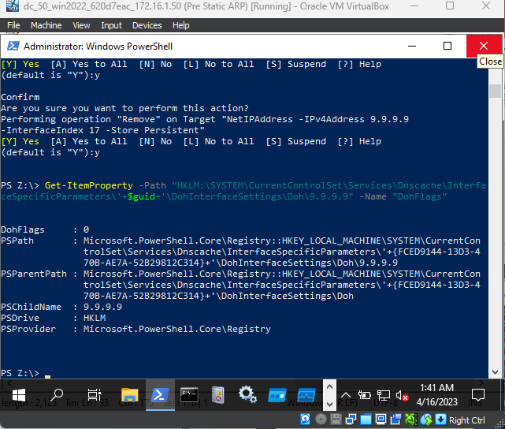
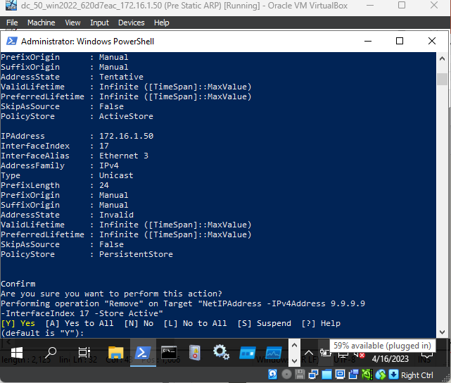
Function resetDoH ()
Tested adding original IP and removing new IP
Tested changing the DoHflags value is changed to 0

Slide 9
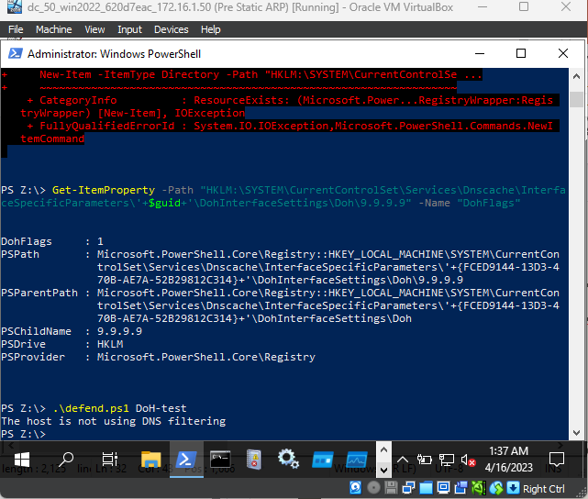
Testing DoH
Does not use DNS filtering despite testing all attributes are correct for DoH
Checked each possible issue and found no solution despite all functions working as intended
Needs further changes to work as intended

Slide 10
CIS 2.5

Slide 11
This should be implemented using New-AppLockerPolicy
After several tests the commands needed such as
-Action Allow
Was not recognised in PowerShell so there was no way to implement it at this stage.

Slide 12
CIS 2.7

Slide 13
Rational
CIS 2.7 is similar to 2.5
Main difference is the type of files it blocks
As this machine runs scripts to implement security changes restricting access to scripts should also be implemented.

Slide 14
This should be implemented using New-AppLockerPolicy
After several tests the commands needed such as
-Action Allow
Was not recognised in PowerShell so there was no way to implement it at this stage.

Slide 15
Attack

Slide 16
BumbleBee
Gains initial access
Can execute commands/payloads once initialised
Ransomware

Slide 17
BumbleBee
T1047 – Windows Management Instrumentation
T1566 – Phishing
T1548.002 – Abuse Elevation Control Mechanism: Bypass User Account Control
T1041 – Exfiltration Over C2 Channel
T1053.005 – Scheduled Task/Job: Scheduled Task

Slide 18
Rational
There is a large number of sub/techniques that can be used by the BumbleBee software, a few of those techniques are more important than others. The simplest way to find these key techniques is to ask, “If this technique is no longer used can the software still be successful”. The following techniques are all required for the software and it will not function without them.

Slide 19
T1047 – Windows Management Instrumentation
All malicious software requires a form of execution. WMI is a feature that gives environment access both locally and remotely. This means it can give attackers a way to execute the malicious files on target machines remotely. Without this technique BumbleBee could sit idle on a machine and cause no harm as nothing will be executed.

Slide 20
T1566 – Phishing
BumbleBee uses two of the sub techniques withing T1566 however I will group them in one as they serve the same purpose of phishing just different scenarios. T1566.001, spearphishing attachment and T1566.002 which is in simple terms having a malicious file attached to the email, spearphishing link which is similar to the prior mention sub technique except a link is used instead of an attachment, are the two sub techniques that are used by the software. I have selected these sub techniques as examples for how the software can arrive on the target machine, there are other sub techniques that may also be used. BumbleBee requires the target computer/network to run the software in some way or another. Phishing is one of the possible methods of achieving this, if the software never arrives at the target, it cannot be run.

Slide 21
T1548.002 – Abuse Elevation Control Mechanism: Bypass User Account Control
When attacks occur on systems a lot of the software/scripts used may require administrator permission to run successfully. This can potentially stop an attack in its tracks if the user does not have that permission or simply clicks no if they do. This would be the case of BumbleBee, but to avoid this BumbleBee uses T1548.002. Without the use of this sub technique attacks would likely be stopped before anything can be run on the target machine.

Slide 22
T1041 – Exfiltration Over C2 Channel
This technique is used to exfiltrate the data that has been stolen by attackers. The stolen data is returned to the attacker over the ‘C2’ channel. This is a communication channel which is usually hidden so systems cannot see it. This technique is important to BumbleBee as one of the primary goals of the software is to allow ransomware, so a channel for communication gives the attacker a way to retrieve the stolen information. If the software cannot communicate back the stolen data or send commands to run over the channel, then the software will not achieve its goal.

Slide 23
T1053.005 – Scheduled Task/Job: Scheduled Task
The purpose of BumbleBee is to install and execute additional software and commands down the track after it has infected a system using WMI and the previous mentioned techniques. To achieve this some form of persistence needs to be secured. BumbleBee uses Scheduled Tasks to establish persistence. Without this sub technique no additional payloads could be executed or delivered after the initial delivery of BumbleBee.

Slide 24
Emulation

Slide 25
Attack Detection
<rule id="115001" level="10">
<if_group>windows</if_group>
<field name="win.eventdata.ruleName"
type="pcre2">technique_id=T1047</field>
<description>WMI execution on $(win.system.computer)</description>
<field name="win.eventdata.originalFileName" negate="yes" type="pcre2">.*Wmiprvse.exe</field>
<field name="win.eventdata.originalFileName" negate="yes" type="pcre2">.*wmiutils.dll</field>
<mitre>
<id>T1047</id>
</mitre>
</rule>

Slide 26
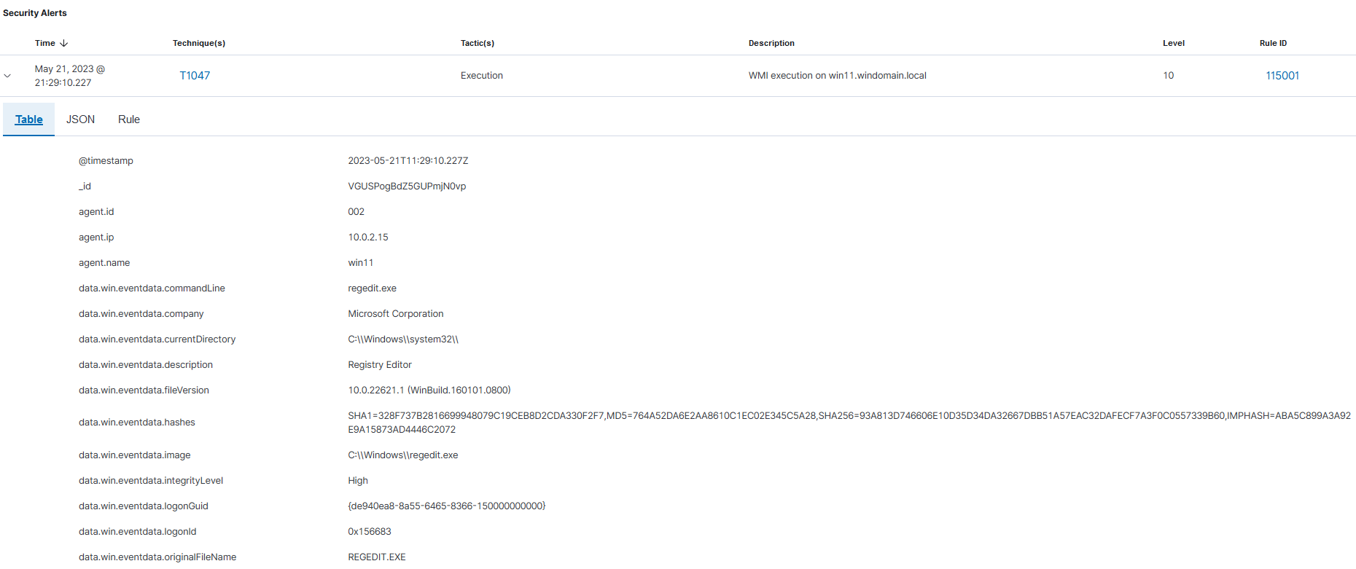
Detection – T1047

Slide 27
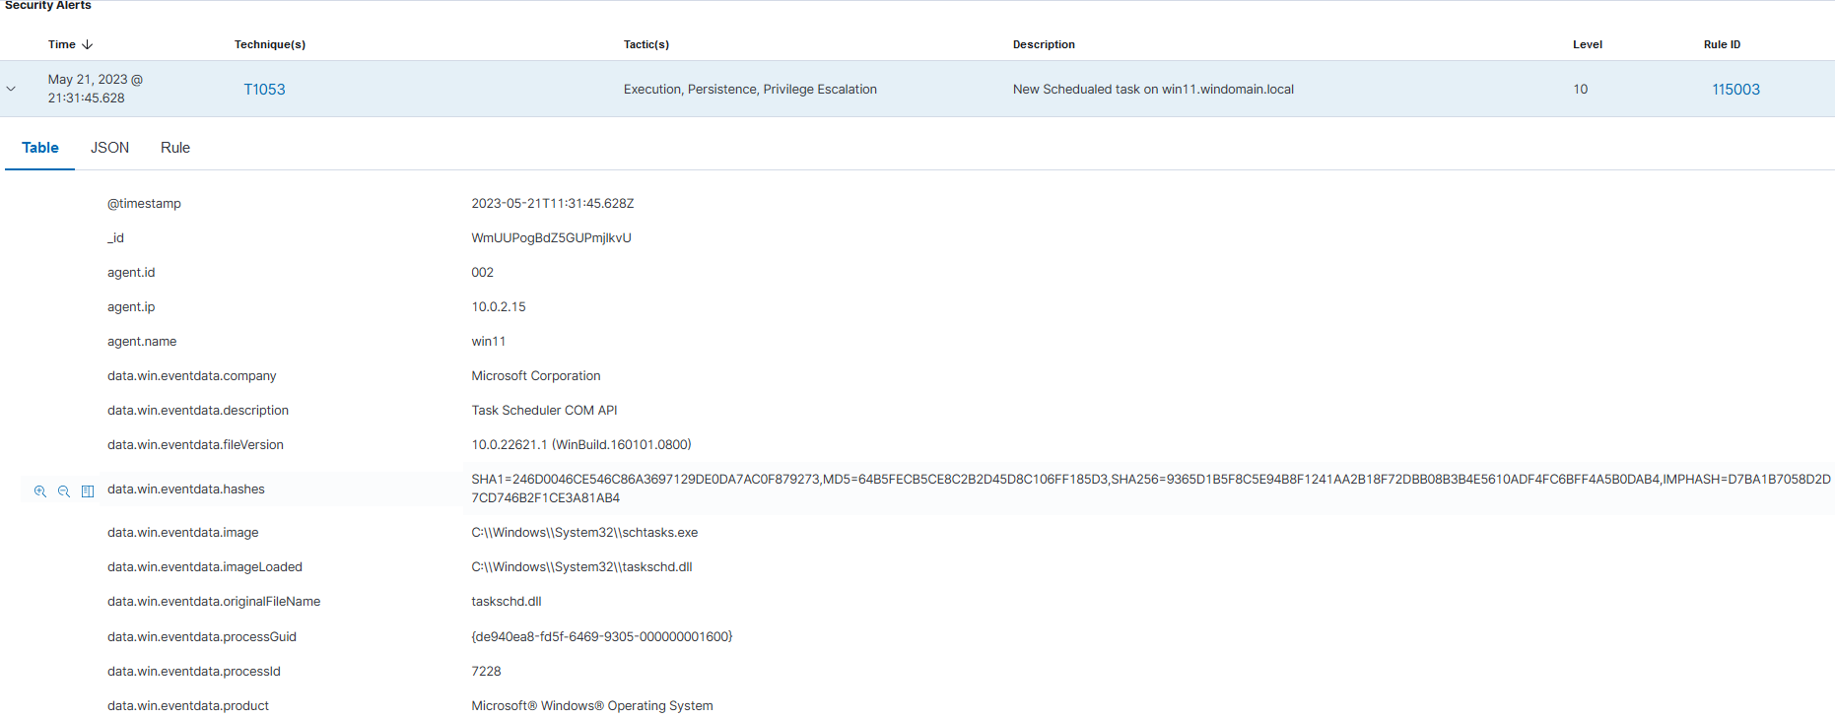
Detection – T1053.005

Slide 28
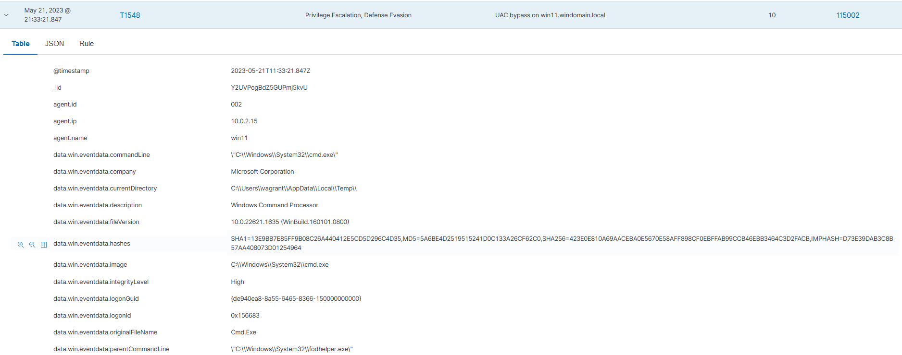
Detection – T1548.002

Slide 29
Vulnerability searches

Slide 30
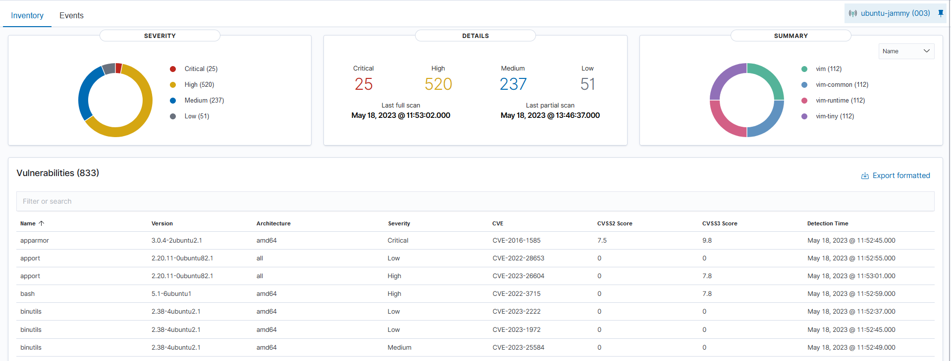
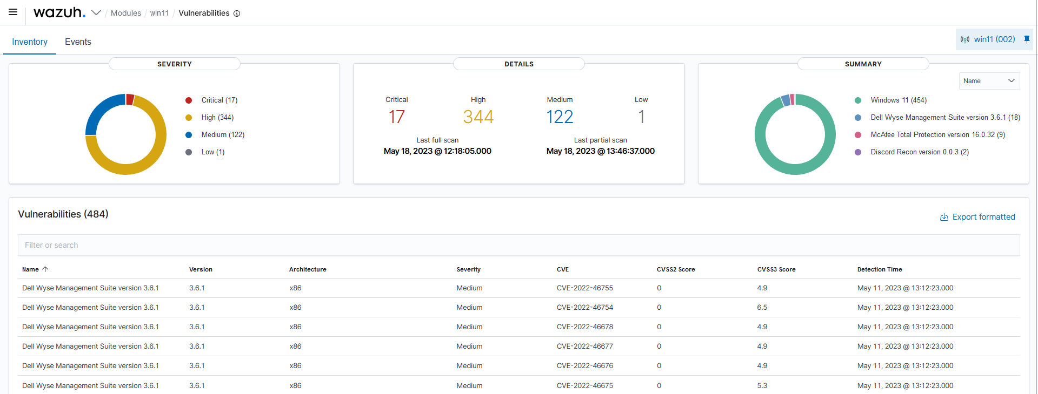
Wazuh

Slide 31
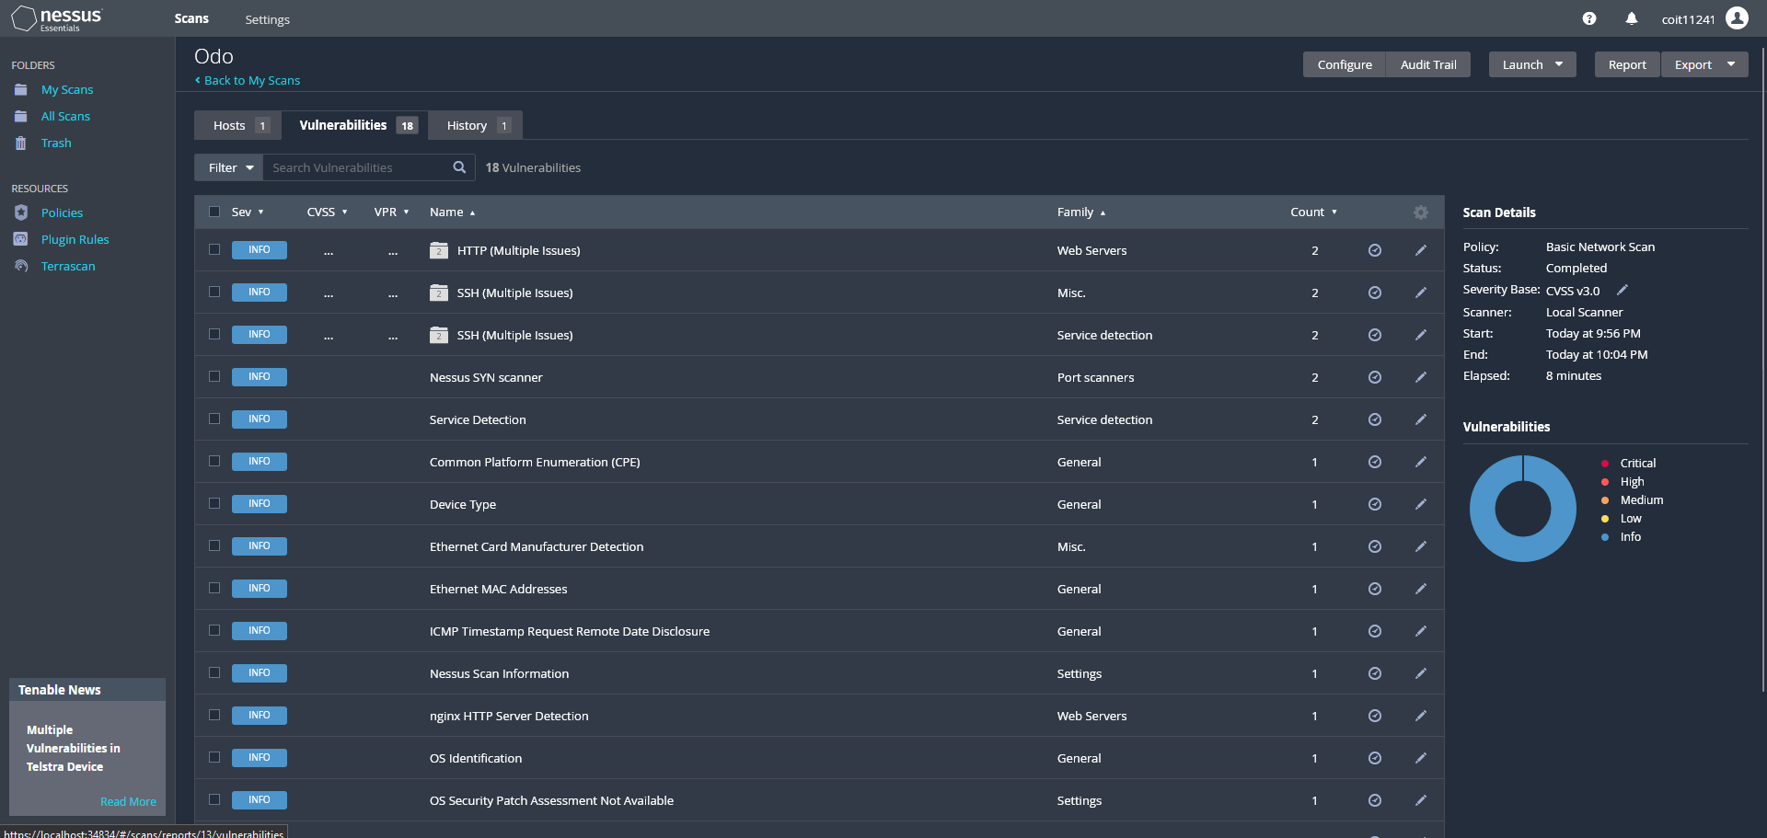
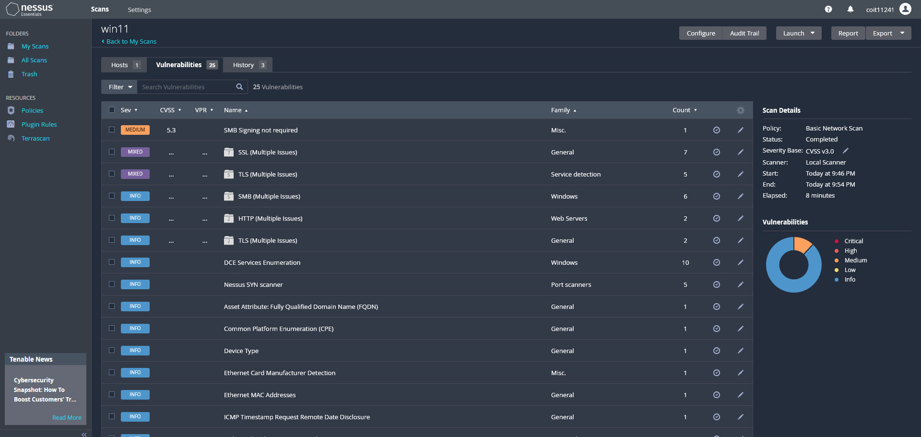
Nessus

Slide 32
CVE-2021-29465
CWE | CAPEC | ATT&CK | Used by BumbleBee
CWE-94: Improper Control of Generation of Code ('Code Injection') | CAPEC – 35 Leverage Executable Code in Non-Executable Files | 1027.00 Obfuscated Files or Information: HTML Smuggling | Yes
 |  | 1027.00 Obfuscated Files or Information: Embedded Payloads | Yes
 |  | 1564.00 Hide Artifacts: Resource Forking | No

Slide 33
CVE-2022-33928
CWE | CAPEC | ATT&CK | Used by BumbleBee
CWE-312: Cleartext Storage of Sensitive Information | CAPEC-37: Retrieve Embedded Sensitive Data | 1005 Data from Local System | Yes
 |  | 1552.00 Unsecured Credentials: Private Keys | No

Slide 34
CVE-2020-7283
CWE | CAPEC | ATT&CK | Used by BumbleBee
CWE-269: Improper Privilege Management | CAPEC-233: Privilege Escalation | 1548 Abuse Elevation Control Mechanism | Yes

Slide 35
CVE-2022-43751
CWE | CAPEC | ATT&CK | Used by BumbleBee
CWE-427: Uncontrolled Search Path Element | CAPEC-38 Leveraging/Manipulating Configuration File Search Paths | 1574.00 Hijack Execution Flow: Path Interception by PATH Environment Variable | No
 |  | 1574.00 Hijack Execution Flow: Path Interception by Unquoted Path | No
 | CAPEC-471: Search Order Hijacking | 1574.00 Hijack Execution Flow:DLL search order hijacking | No

Slide 36
CVE-2022-46754
CWE | CAPEC | ATT&CK | Used by BumbleBee
CWE-284: Improper Access Control | CAPEC-19: Embedding Scripts within Scripts | 1027.00 Obfuscated Files or Information: Embedded Payloads | Yes
 |  | 1546.00 Event Triggered Execution:.bash_profile and .bashrc | No
 |  | 1546.01 Event Triggered Execution: Installer Packages | No

Slide 37
Rational
The key reason for which CVEs I included was the CVSS3 Score
If the score was high I would check those CVEs first
After that I would check if they had Att&ck codes that might be related
From there I could then decide if it would be relevant or not to look into.
They are prioritised in order by CVSS3 score and relevance and are in order in slides most important to least important.

